Slide 1
Types of Managers
3 types
First-line managers (supervisors):
-stand at the base level of manger’s hierarchy
-daily supervision of non managerial employees- actually perform activities to convert i/p to o/p(goods n services)
-all dept
-primary concern is the application of rules and procedures to motivate
employees-achieve results.
-also called as line mgrs, section chiefs and office mgrs
- need more technical skills

Slide 2
2) Middle Managers:
-work at middle level of org
- responsible to organize resources in the best way to achieve org goals.
-head various dept in the org
-They help first line mgrs and non managerial employees to better utilize resources to reduce manufacturing costs and to improve services provided to the customers.
- TO CHECK GOAL IS ACHIEVING-IF NOT SUGGESTIONS
-Middle mgrs found everywhere in the org.
-like “glue” ---holds companies together.
-bridging the gap b/w top level mgmt and lower level workers
-implement strategies and org changes
-keeping workers engaged in their work during good or bad economic cycles.
Translate strategies which can be understood by workers
Also note down the workers’ need

Slide 3
3) Top Managers:
sit at the top position and responsible for the entire org.
set goals-define strategies to achieve goals
monitor and interpret the env
make decisions
c/m with employees down the line-talk about goals-achieve
Shaping and sustaining corporate culture
manages the company changes
Responsible for success/failure of an org and
keep their performance continuously scrutinized by all the stakeholders
-Top mgr-different designations-CEO, MD , Presidents, Chairpersons and Executive Vice-Presidents.
Need more conceptual skills
-Managers at all levels need human skills in equal proportions

Slide 4
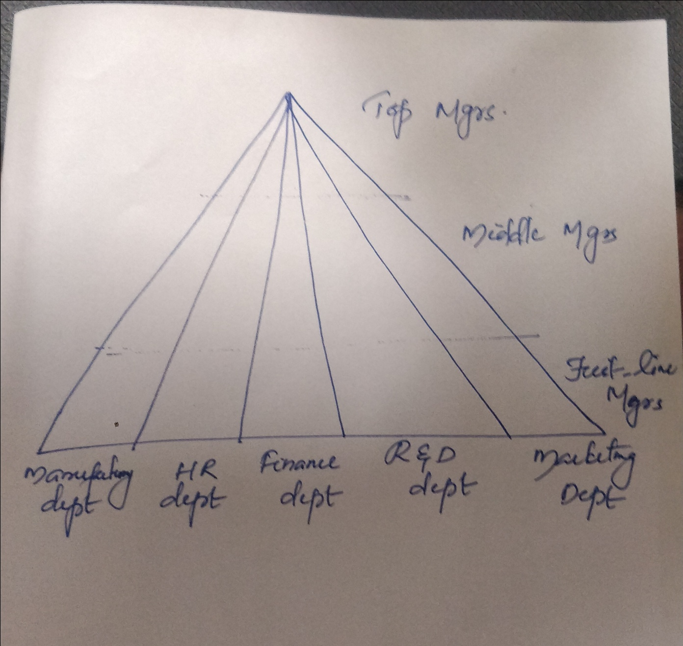

Slide 5
Contemporary Trends in Management Thinking
Mgmt dynamic subject-keeps on changing-flexible-open-growing-disciplined.
Some practices are prominent in the mgmt thought.
1)Inventing and reinventing org:
Mgrs search for ways to release the creative potential of their emp and themselves.
Destroying traditional structure, flattening and removing artificial barriers to improve efficiency and effectiveness of org.
2) Globalization :
Open new challenges and opportunities.
Mgrs of today think as global citizens
They treat world as market and emp do not come from one country or one region.(multi culture and multi regions)
Nowadays Indian companies are establishing their global presence in organic and in organic ways.

Slide 6
3) Building Management Capability:
Management capability is critical to sustainable performance and growth.
→Management capability is the sum total of the following dimensions:
Organizational effectiveness and comparative performance
Visionary and strategic leadership
Performance leadership
People leadership
Financial performance/management
Organizational capability
Innovation
External relationships
Application of technology and knowledge
Integrity and corporate governance
Attempts have been made to measure management capability of an organisation. Management Capability Index (MCI) is the technique used for the purpose
The overall Indian MCI for the year 2010 was 74.6 per cent which implies that the Indian corporate are performing at 75 per cent of their potential. Performance must be to the full potential.

Slide 7
4) Mergers and Acquisitions (M&As):
As stated earlier, organisations adopt inorganic (M&As)route to grow big.
Indian companies are gung-ho in acquiring overseas companies.
What needs primary consideration in a merger or takeover is blending of policies and practices between the acquirer and the acquired companies.
Failing on this will have serious consequences.
State-owned airlines in India faced this problem. A few years back, Indian Airlines and Air India were merged but pay disparities among the employees of both the airlines were allowed to continue resulting in a strike by the pilots and ground staff.

Slide 8
More than the policies, it is the fusion of cultures that is more significant. The merger in 2003 between Bank of Madura and ICICl was a
marriage between two unequals. Bank of Madura appeared bigger with 2.6 million customers and 2,400 employees. ICICI had a headcount of only 1,600. The average age of the ICICrs employees was 28 years and it rose to 43 when both merged. It goes to the credit of lCICI that it has managed fusion of culture too successfully.
5)Diversity:
Org. no longer mono-cultural entities.
Multi cultural
They are made up of people from different regions, religions, states and fashions.
6)Making an ethically Honest and Socially Conscious firm
Managers need to be ethically honest and be responsive to the social needs.

